Slide 1
Smart Lock for Passwords
Author: Sonny Shih
Date: 2016/02/25

Slide 2
Smart Lock for Passwords 說明
https://developers.google.com/identity/smartlock-passwords/android/
官網範例
https://codelabs.developers.google.com/codelabs/android-smart-lock/#0
Google 帳號管理中心
https://passwords.google.com

Slide 3
Overview
What is Smart Lock for Passwords?
Save both username-password credentials
Federated identity provider credentials
Automatically sign-in/ sign-up to the app using the credentials.
Provide the Credentials API.
https://developers.google.com/android/reference/com/google/android/gms/auth/api/credentials/package-summary

Slide 4
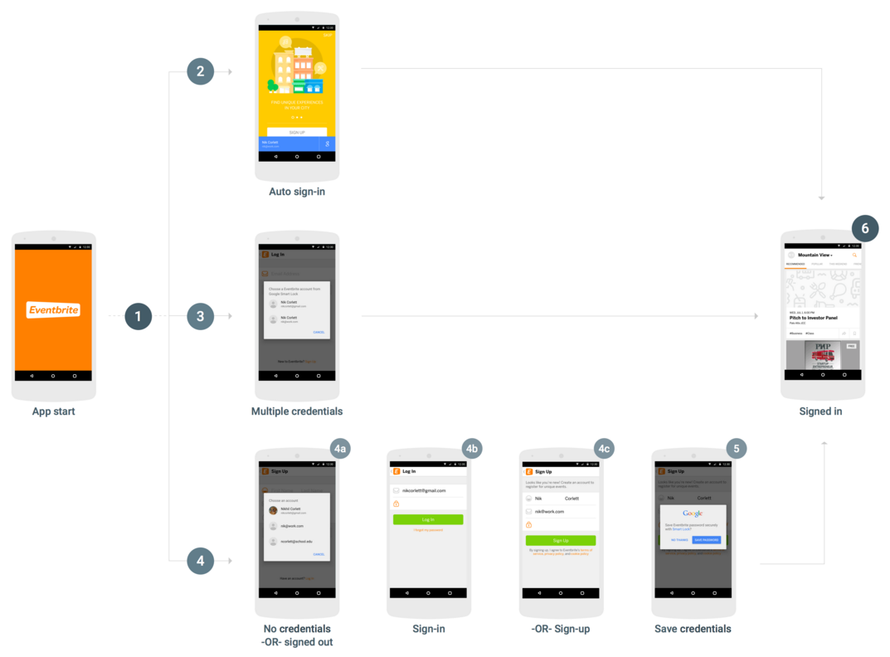
Overview
Following diagram

Slide 5
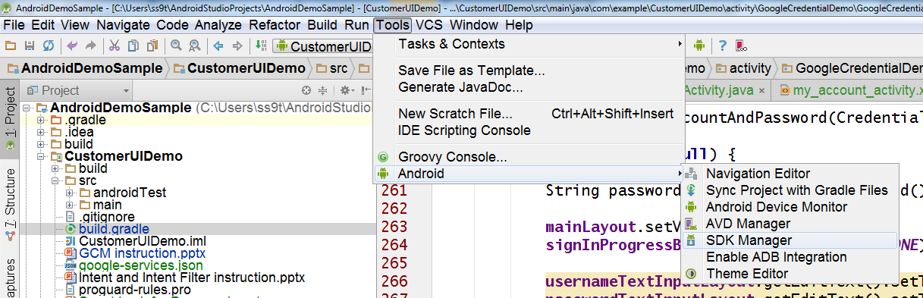
開發環境設定 (1/3)
Android Studio 模擬器
安裝Google Play services套件

Slide 6
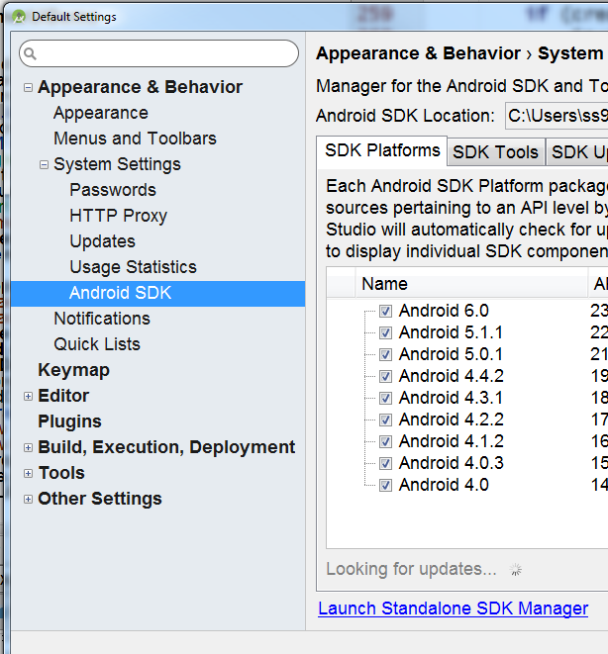
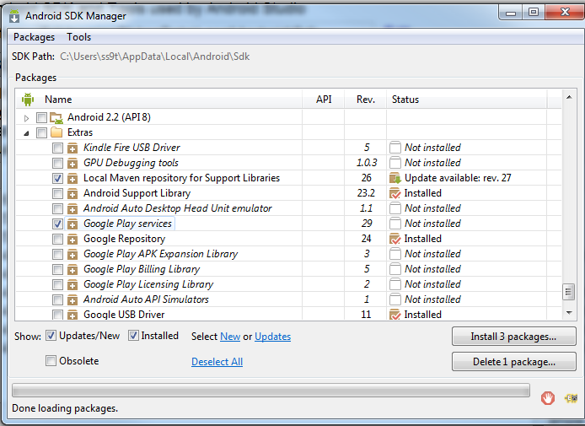
開發環境設定 (2/3)
打勾安裝

Slide 7
開發環境設定 (3/3)
Genymotion 安裝 Google Play服務
http://inthecheesefactory.com/blog/how-to-install-google-services-on-genymotion/en

Slide 8
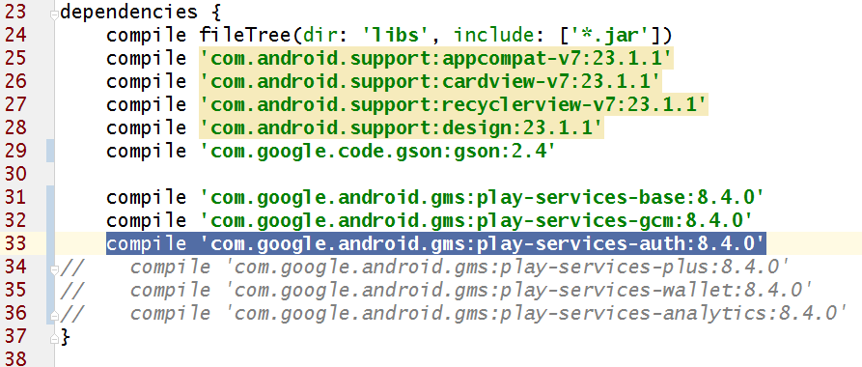
設定App Level gradle 檔案
設定App Level的build.gradle
增加dependencies
compile 'com.google.android.gms:play-services-auth:8.4.0'

Slide 9
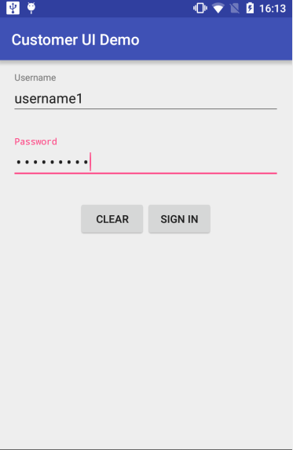
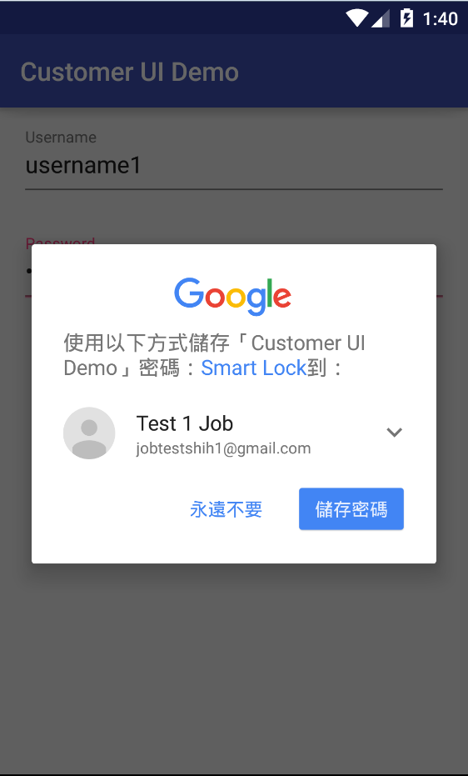
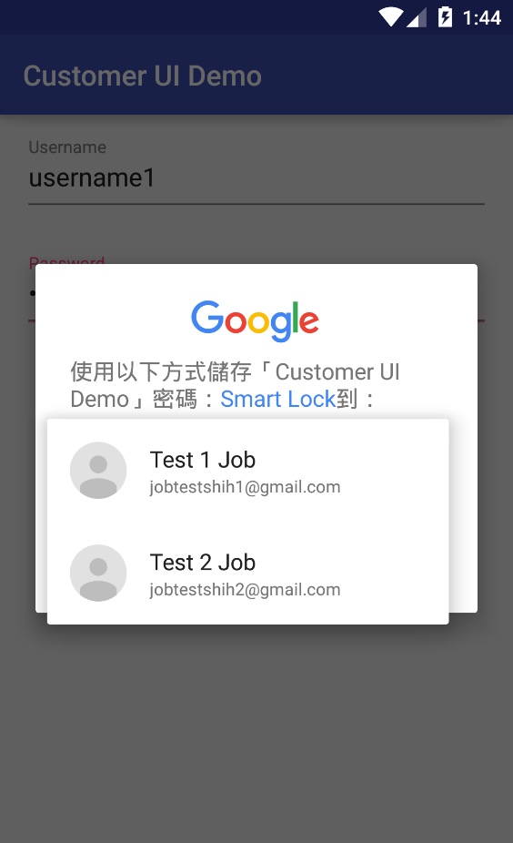
選擇儲存Google帳號
選擇把帳號要存在
哪一個Google帳號下

Slide 10
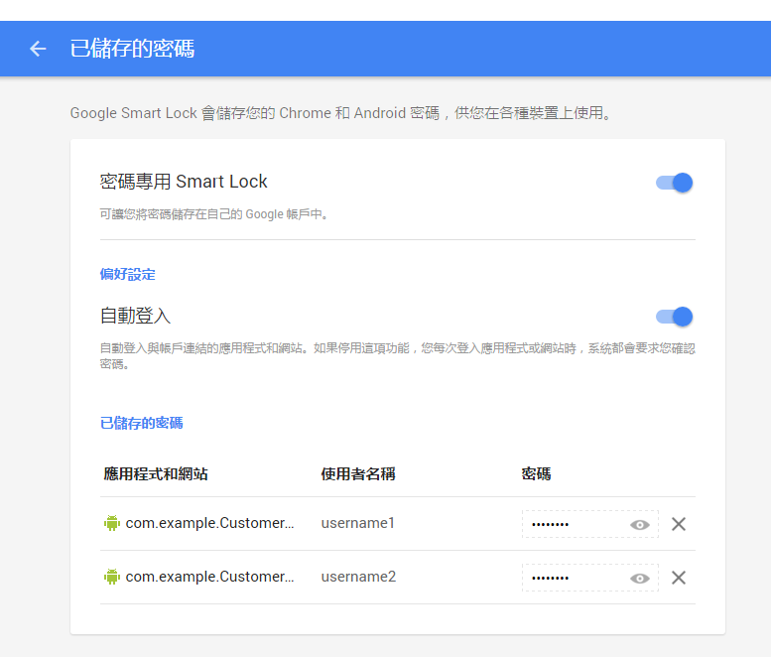
帳號管理
Google 帳號管理
https://passwords.google.com

Slide 11
解除”永遠不要” (1/3)

Slide 12
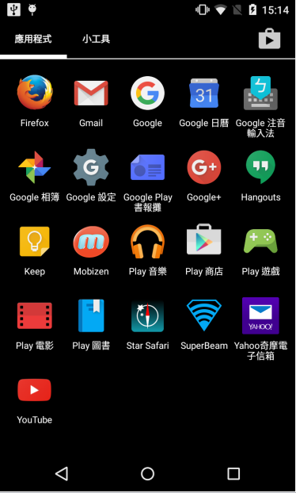
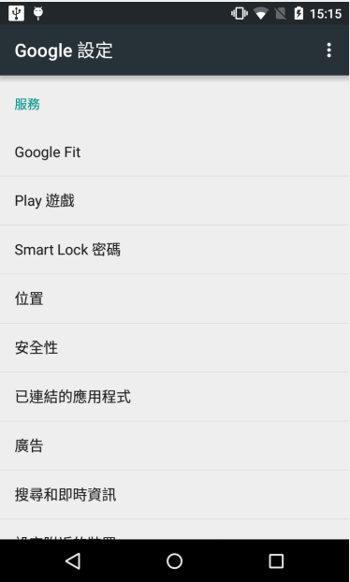
解除”永遠不要” (2/3)

Slide 13
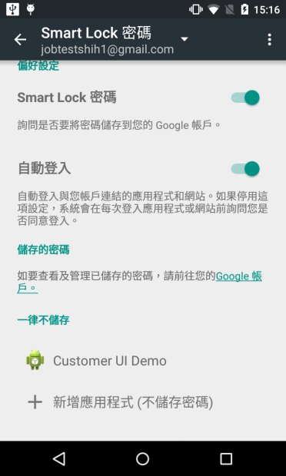
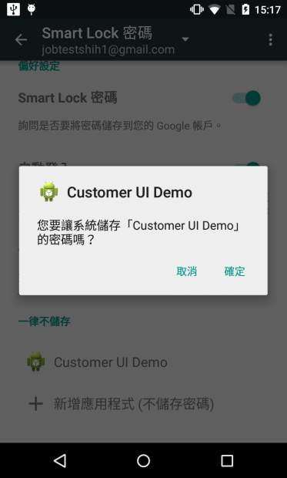
解除”永遠不要” (3/3)

